Slide 1


GMR Institute Of Technology, Rajam
Department of IT
Deep Learning Techniques for Smart Farming
based on Soil and Environmental Factors.
Project Supervisor R. Sathish ( 19341A1296 )
Ms. T Daniya, T. Prem Chand ( 19341A12B7 )
Asst. Professor, G. Sai Ram Prudhvi ( 19341A1297 )
Dept. of Information Technology M. Vyas Kanmani ( 19341A1268 )
1
19-Jul-19
1

Slide 2
ABSTRACT
Agriculture plays a critical role to Indian global economy and contributes a major part to GDP. The yield of a crop is mainly determined by the climatic conditions like temperature, rainfall, soil conditions, and fertilizers. In this project a new technique for smart farming where different machine learning algorithms such as KNN Classifier, SVM, Ensembled learning techniques are applied to predict the more profitable crop and suitable fertilizers. Ensemble learning techniques such as Random Forest, XG Boost works by building a strong learner on many weak learners and they will perform far more better in this prediction problems. Even though we cultivate a best crop and provide a suitable fertilizer some times crops may get damaged by their diseases. It is very difficult to identify the diseases in the paddy field. But it can be achieved by applying deep learning techniques with CNN and Transfer learning. If we can detect the disease we can suggest solution according severity of disease by a manual data dictionary. Convolutional Networks performs information extraction from images by applying several filters through convolutions and Transfer learning provides pre-trained models built upon large datasets and applies the knowledge acquired from those datasets to solve some other problem. In simple words it is the transfer of knowledge from one experience to solve other problem. Several transfer learning architectures include Efficient Net, ResNet, VGG16 Etc. A web application is made up by using Html, CSS, JavaScript and Flask to deploy in a cloud server for all these models to be used in general use case.
Keywords: Soil, Fertilizer, Paddy Fields, Machine Learning Algorithms, Deep Learning, Transfer Learning.

Slide 3
PROBLEM STATEMENT
In agriculture sector there are lot of factors effecting the cultivation of crops in the fields such as soil and environmental conditions. But there is no proper system for decision making in accordance with these factors such as more yielding crop, suitable fertilizers and taking necessary action in order to pesticide the crop to eliminate diseases occur in mean time. If we don’t take correct decision on these factors we may not get proper production results in fields.

Slide 4
OBJECTIVES
The proposed system tries to implement a crop management system with following features :
Suggest a best crop which gives more yield with given features of soil and weather.
Suggest a suitable fertilizer with given crop and soil features by machine learning.
Determine the type of disease occurred in the paddy fields with given plant images by using deep learning and suggesting corresponding solution to cure the disease.

Slide 5
EXISTING SYSTEM
The current existing crop management systems are based on the human suggestions and may not be reliable sometimes.
Even though there are enough knowledge, techniques, and methods which are done manually available in agriculture, there is no system in which the environmental factors are detected and suggests the user which crop type is best for farming.
There are many systems for detection of diseases in many plants by deep learning but work done in the paddy crops is very less.

Slide 6
Literature Survey - 1
1. M. Alencastre-Miranda, R. M. Johnson and H. I. Krebs, “Convolutional Neural Networks and Transfer Learning for Quality Inspection of Different Sugarcane Varieties,” in IEEE Transactions on Industrial Informatics.
Computer vision and deep learning techniques are used in this paper to select and plant healthy billets in order to increase Sugar Cane plant population and yield per hectare.
Dataset description :
The dataset for the training model was obtained from the USDA Sugarcane Research Farm. The Sugarcane dataset is based on three varieties of sugarcane collected from farms and classified by experts as good and damaged billets.
Variety | Total billets | Damaged | Good
HoCP 09-804 | 1397 | 864 | 533
HoCP 96-540 | 1072 | 679 | 393
L 01-299 | 405 | 242 | 163

Slide 7
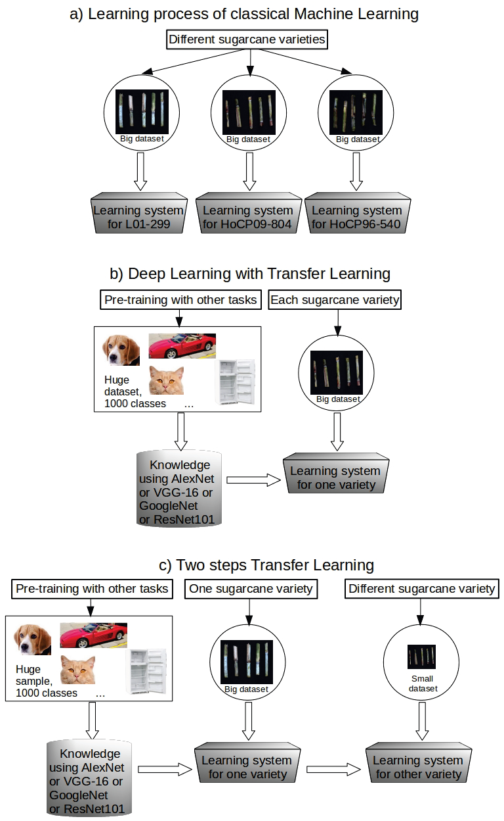
Literature Survey - 1
Key Techniques :
Two step Transfer Learning Process with following CNN Architectures :
Alex Net VGG-16 GoogLe Net ResNet101

Slide 8
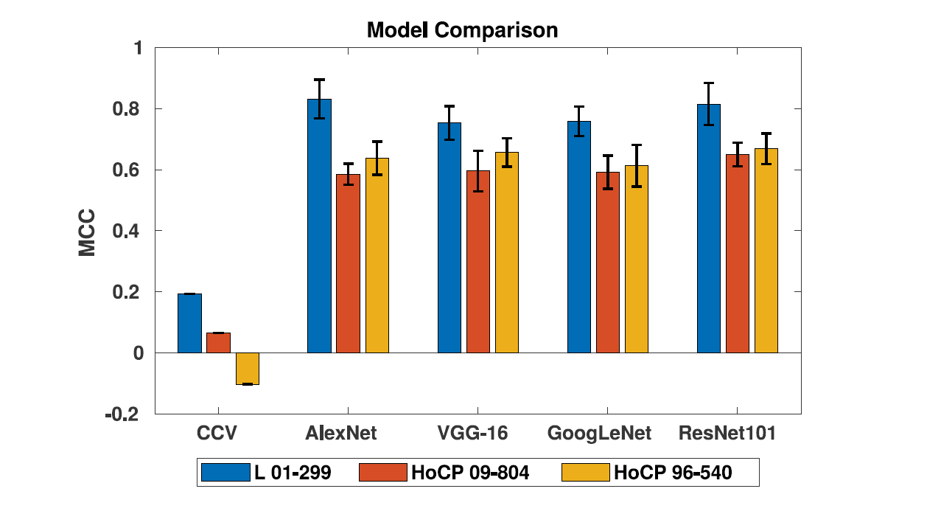
Literature Survey - 1
Results
Here Among four selected architectures produced similar results (TNR, TPR, MCC, and percentage of good billets to plant), but ResNet101 and AlexNet produced the best results for different sugarcane varieties. ResNet101, on the other hand, required an excessive amount of processing time (around 10 to 20 times longer). AlexNet appears to be the best option for them, and it is implemented in a two-step transfer learning process that resulted in approximately 22 times fewer billets required to retrain the network for a new sugarcane variety.

Slide 9
Literature Survey - 2
2. Li, Wei, Tengfei Zhu, Xiaoyu Li, Jianzhang Dong, and Jun Liu. 2022. “Recommending Advanced Deep Learning Models for Efficient Insect Pest Detection Agriculture” 12, no. 7: 1065.
This paper describes the deep learning techniqes for detection of insect pests in crop fields.
Mainly employed two type of algorithms: One stage Algorithm : Yolo V5 Two stage Algorithm : Faster RCNN & Mask RCNN
One stage algorithms directly extracting features from images and detect the object location and classify them. These will output the (Coordinates of object such as bounding boxes) in the image and then classify that bounding box. these are relatively fast as there is no need of region proposal.
But two stage algorithms will generate a region of interest for objects in the image( such as masks for the object and then extracts features from them to classify them. these models are relatively fast as intermediatory stage of finding the regions included.
However the one stage algorithms performed fast and better in a simple datasets involving less complexity. Two stage algorithms performed better on datasets having complex background.

Slide 10
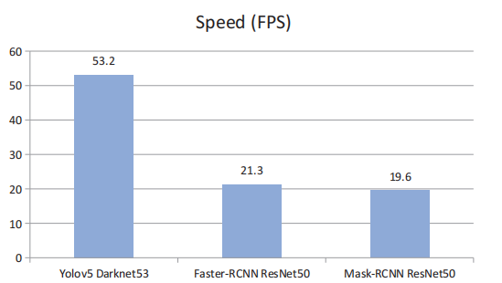
Literature Survey - 2
Key techniques
Deep Convolutional Neural Network Models :
Faster RCNN & Mask RCNN Model : ( 98% on Baidu Ai & 99% on IP102 )
YOLO v5 Model : ( 99% on Baidu Ai & 97% on IP102 )
Training speed comparison of DL Models

Slide 11
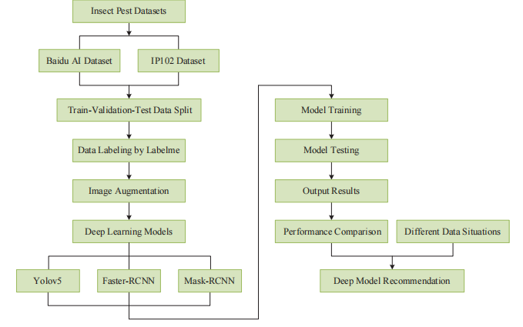
Literature Survey - 2
The overall flow chart of this work.
Limitation :
Lack of high adaptability to different image situations (changes from case to case).
Manual Labeling is time consuming.
Requires lot of computational power to train these complex models.

Slide 12
Literature Survey - 3
3. Elavarasan, D., & Vincent, P. M. D. (2020). “ Crop Yield Prediction Using Deep Reinforcement Learning Model for Sustainable Agrarian Applications”. IEEE Access, 8, 86886–86901.
This paper proposed a Deep Recurrent Q-Network models of Reinforcement learning in order to estimate the yield of a crop with given crop parameters. They collected data from paddy crops in the Vellore district of Southern part of India. data parameters include :
The paddy crop yield is estimated in terms of area cultivated (in hectares), paddy production (in tons) and yield acquired (in kg/hectare).
The independent features include several factors such as climatic factors, The soil parameters and Distinctive hydro-chemical properties of groundwater.
This paper constructs a Deep Recurrent Q-Network model which is a Recurrent Neural Network deep learning algorithm over the Q-Learning reinforcement learning algorithm to forecast the crop yield. The reinforcement learning agent incorporates a combination of parametric features with the threshold that assist in predicting crop yield. Finally, the agent receives an aggregate score for the actions performed by minimizing the error and maximizing the forecast accuracy. The proposed model efficiently predicts the crop yield outperforming existing models by preserving the original data distribution with an accuracy of 93.7%.

Slide 13
Literature Survey - 3
The agent will get rewards on the correct actions performed and penalties for the wrong actions. The agent learns by itself without human intervention by increasing its rewards and limiting its penalties.
Reinforcement Learning:
Propagation process of recurrent neural network.

Slide 14
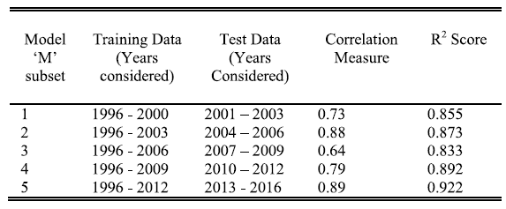
Literature Survey - 3
During the construction of machine learning models, the dataset is arbitrarily split into training and test set, where the highest amount of data is taken as the training set. Even though the test dataset is small, there exist chances of leaving out some important information that may have enhanced the model. Also, there is a concern of high variance in the dataset. To handle this issue, K-fold cross-validation is utilized.
Results of 5- fold forward chaining cross-validation for the deep reinforcement model M.

Slide 15
Literature Survey - 4
4. Ganesh, P. (2017). Leaf Disease Detection and Selection of Fertilizers using Artificial Neural Network.
Most people make their living in agriculture and rely entirely on agricultural products. If a plant becomes impacted, it reduces both the quality and quantity of agricultural crops. Hence, Disease detection and analysis are required. Authentic crop disease exposure and recognition is essential for properly regulating and preventing disease for sustainable agriculture and food preservation. Thus, early disease detection and diagnosis are important for farmers.
Key Techniques:
Image Preprocessing (include Resize Image, Filter Image, Segment Image, Crop Image, Binarization)
Image segmentation using k-means Clustering
Feature extraction by using Gray Level co-occurrence Matrix (GLCM) along with first order statistical moment’s method.
Fertilizer recommendation based on disease detected.

Slide 16
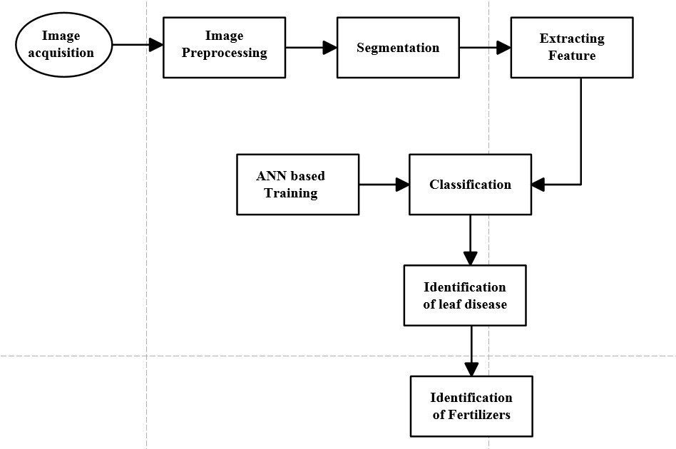
Literature Survey - 4
Description :
This paper included disease identification in lemon and mango plants using image segmentation techniques and the appropriate fertilizer. Several stages are used to identify diseases, such as
Image aquisition
Image Pre-processing Noise Removal - (Adapted median filter after adding soft and pepper noise) Enhanced Contrast - (to improve quality : Adaptive crystogram equalization ) Segmentation - ( to identify diseased area : K means clustering ) Texture feature extraction - ( Gabour texture method )
Classification by Artificial Neural Network.
Fertilizer recommendation by Mapping standard deviation to the fertilizers available.
Limitation :
Segmentation provided some misclassifications.

Slide 17
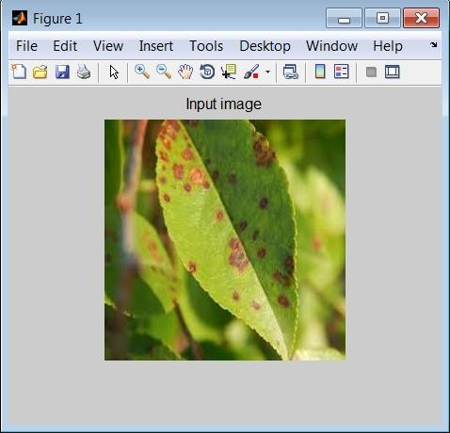
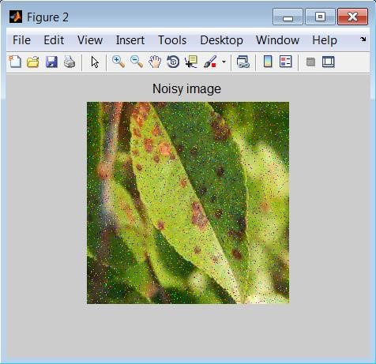

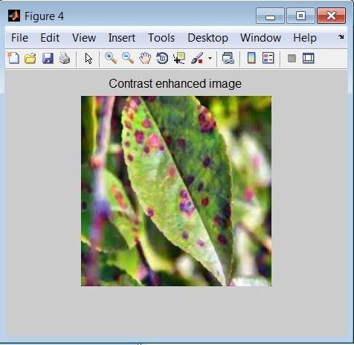
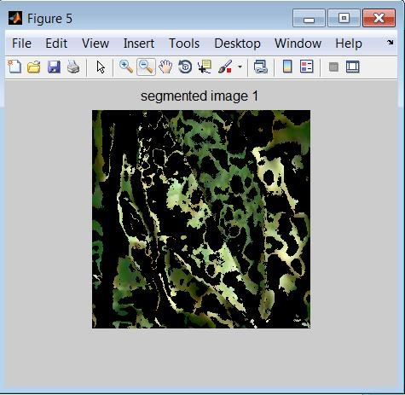
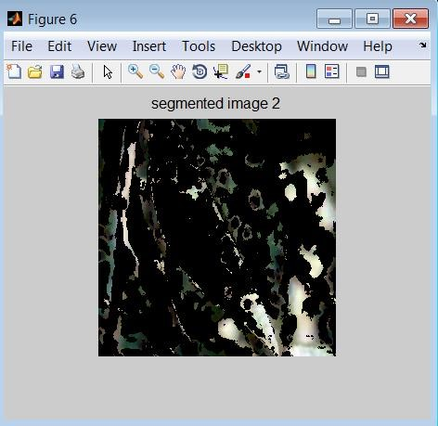
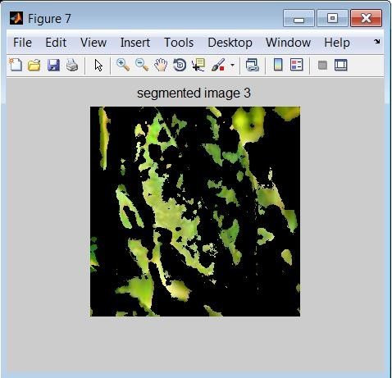
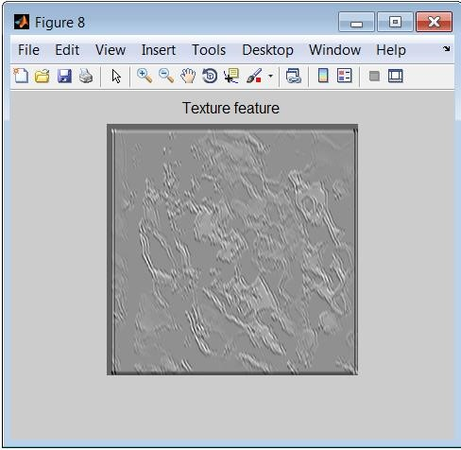
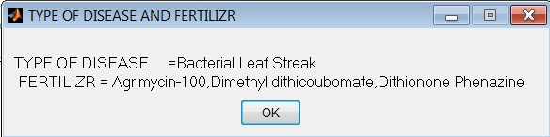
Literature Survey - 4
Input image of lemon image
Noisy image
Noise removal image
Contrast enhanced image
Segment image 1
Segment image 2
Segment image 3
Texture feature
Type of disease and fertilizer

Slide 18
METHODOLOGY
Module 1
Collection and Partition of Data
Module 2
Pre-Processing of Datasets
Training and Evaluation of Models
Module 4
Model selection and Saving the models
Module 5
Module 3
Deployment of Application

Slide 19

METHODOLOGY
System Overview
User
User Interface front-end Application
User Input
Prediction Results
User
Crop Recommendation
Fertilizer Recommendation
Disease detection and Recovery solution
Server

Slide 20
METHODOLOGY
Dataset
Pre-processing
ML Classification Algorithms
Hyper-Parameter Tuning
Evaluating Models
Deployment Models
Pipeline for Crop and Fertilizer recommendation

Slide 21
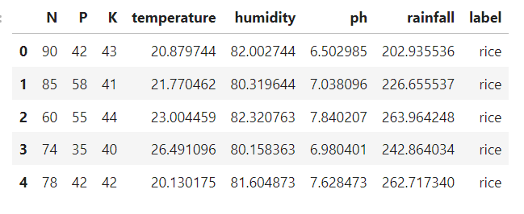
METHODOLOGY
Dataset has been collected from Kaggle and it is partitioned into Training (80%) and Testing(20%) set.
Size of dataset : ( 2200 , 8 )
Data Analysis and Preprocessing :
Univariate Analysis, Bivariate Analysis, Multi variate Analysis
Handling missing values, Label encoding
Model building : KNN Classifier, XGBoost, Random Forest, Decision Tree.
Pipeline from sklearn is used for above process in a sequential automatic way
Hyper-parameter tuning by using GridSearchCV
Crops Dataset

Slide 22
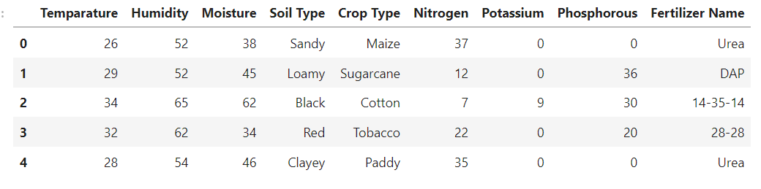
METHODOLOGY
Fertilizers Dataset
Dataset is not balanced and we used Over sampling method by using SMOTE (Synthetic Minority Oversampling Technique ).
Models for classification : SVM , XGBoost, Random Forest.
As both of them are classification problems the Random Forest model performed very better and gave 99% Accuracy on both the datasets. Among all the other models and we have selected the Random Forest Model for deployment.

Slide 23
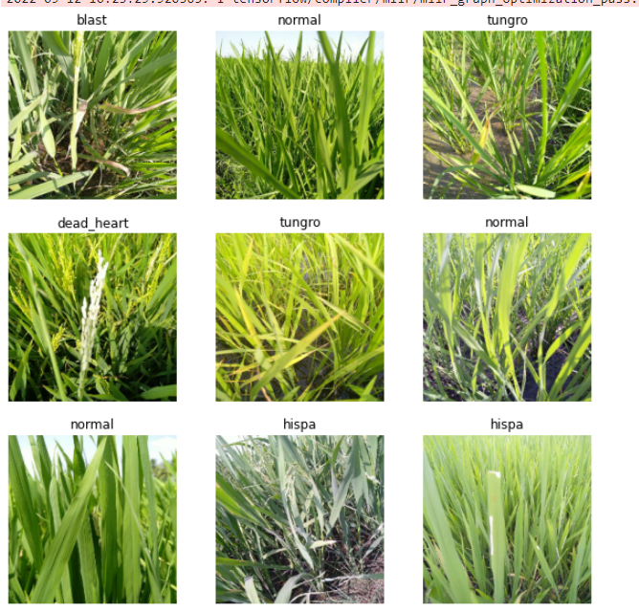
METHODOLOGY
Paddy diseases classification
This module will focus on disease classification in the paddy fields by taking their images as an input
Dataset description
Source : Kaggle ( Plant Doctor )
No. of images : 10407 Images
No. of classes : 10
Train Set size = 8326 Images (80%)
Validation Set = 1040 Images (10%)
Test set = 1040 Images (10%)
The dataset consists of totally 10 types of disease
images of the paddy field.
The disease classes are :
Bacterial_Leaf_Blight , Bacterial_Leaf_Streak, Bacterial_Panicle_Blight,
Blast, Brown Spot, Dead heart, Downy mildew, Hispa, Normal, Tungro

Slide 24
METHODOLOGY
Pre Processing Images and Dataset Generation
Data Augmentation :
The data augmentation helps in visual transformations. The transformation that is mainly focused on image classification are flipping, color modifications, cropping, rotation, geometric transformation, padding, re-scaling, zooming, gray scaling, darkening and brightening, random erasing etc.
Random Rotation, Random Flip, Random Translation, Random Contrast
When you don't have a large image dataset, it's a good practice to artificially introduce sample diversity by applying random, yet realistic, transformations to the training images, such as rotation and horizontal flipping. This helps expose the model to different aspects of the training data and reduce overfitting.
Resizing and Rescaling:
Images are resized to size (224,224) to feed as an input and then rescaled by dividing with 255 so that the pixels values lies between 0 and 1 instead of 0 to 255.
Batching
Images are loaded as a dataset with batches and each batch consisting of 32 Images.

Slide 25
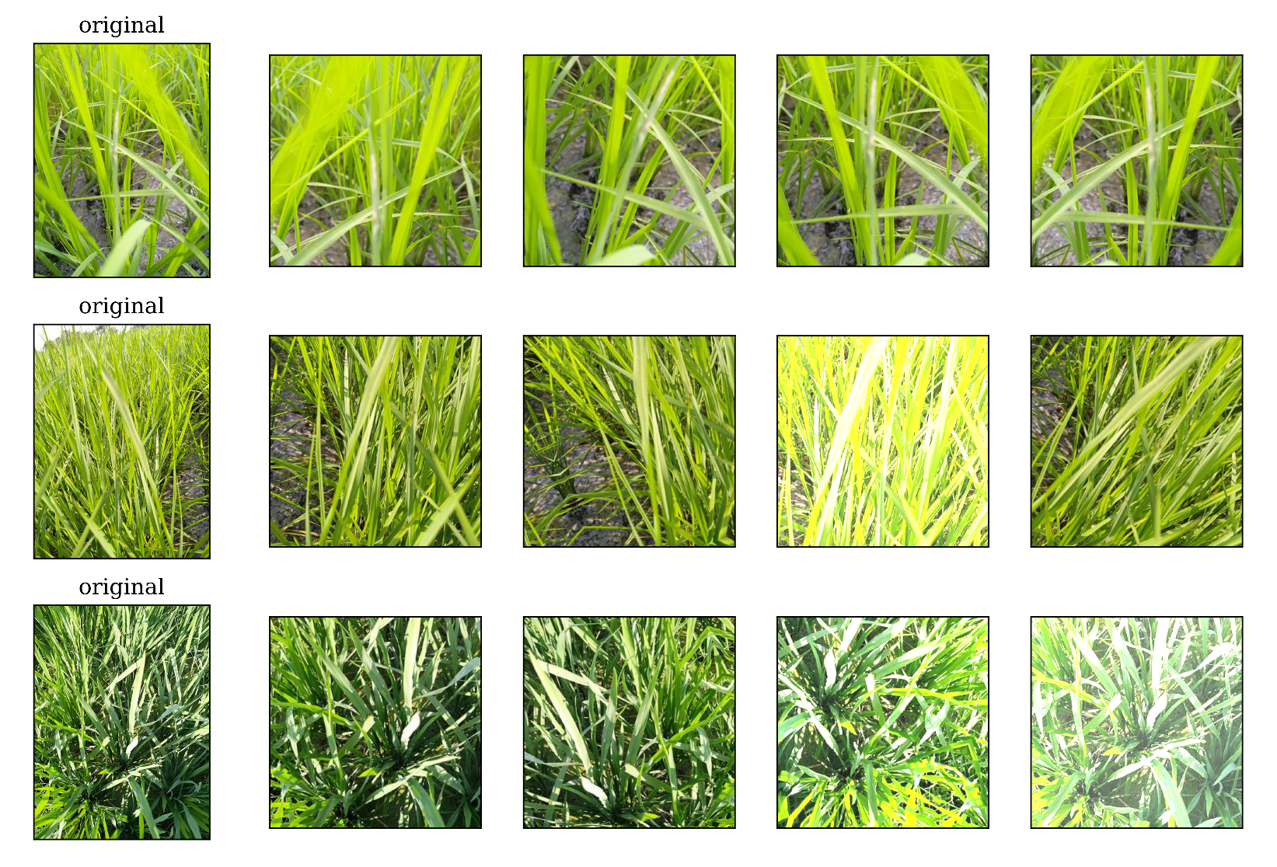
METHODOLOGY
Data Augmentation

Slide 26
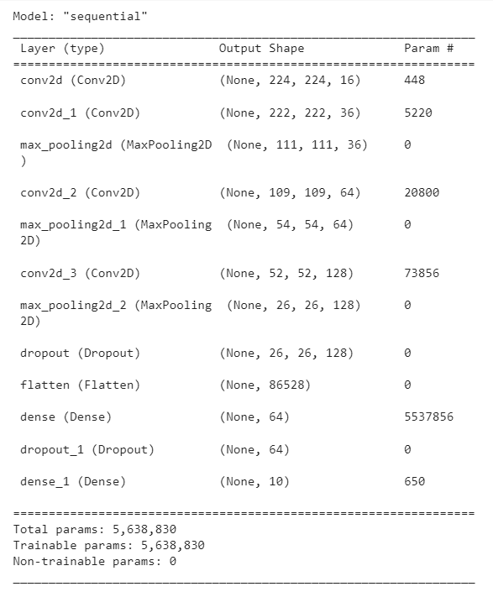
METHODOLOGY
Custom CNN Model :
A custom CNN Model is trained on the given dataset by using TensorFlow keras API.
The input layer takes an image of size (224,224)
This hidden network consists of 4 Convolutional layers with 3 Max pooling layers.
At the end there is a fully connected layer that is Flattened layer with 2 more dense layers for classification. This network consists of 2 dropout layers to prevent over-fitting.
Finally the output layer has 10 units to predict the probability of each target class.
This Network gave 70% accuracy while training and gave 60% in validation and testing
Custom CNN Model

Slide 27
METHODOLOGY
Transfer Learning and Fine Tuning the Models
A pre-trained model is a saved network that was previously trained on a large dataset, typically on a large-scale image-classification task. You either use the pretrained model as is or use transfer learning to customize this model to a given task..
The intuition behind transfer learning for image classification is that if a model is trained on a large and general enough dataset, this model will effectively serve as a generic model of the visual world. You can then take advantage of these learned feature maps without having to start from scratch by training a large model on a large dataset.
Fine Tuning :
One way to increase performance even further is to train (or "fine-tune") the weights of the top layers of the pre-trained model alongside the training of the classifier you added. The training process will force the weights to be tuned from generic feature maps to features associated specifically with the dataset.

Slide 28
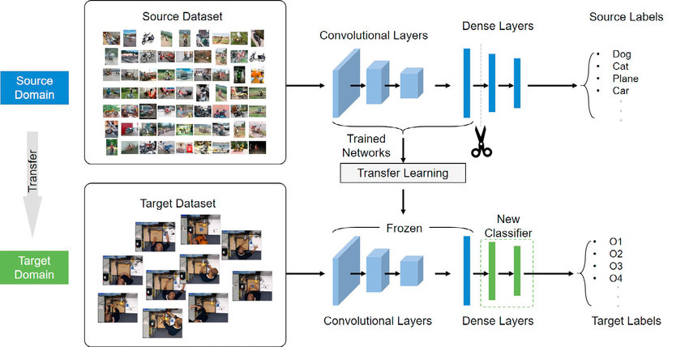
METHODOLOGY
Transfer Learning

Slide 29
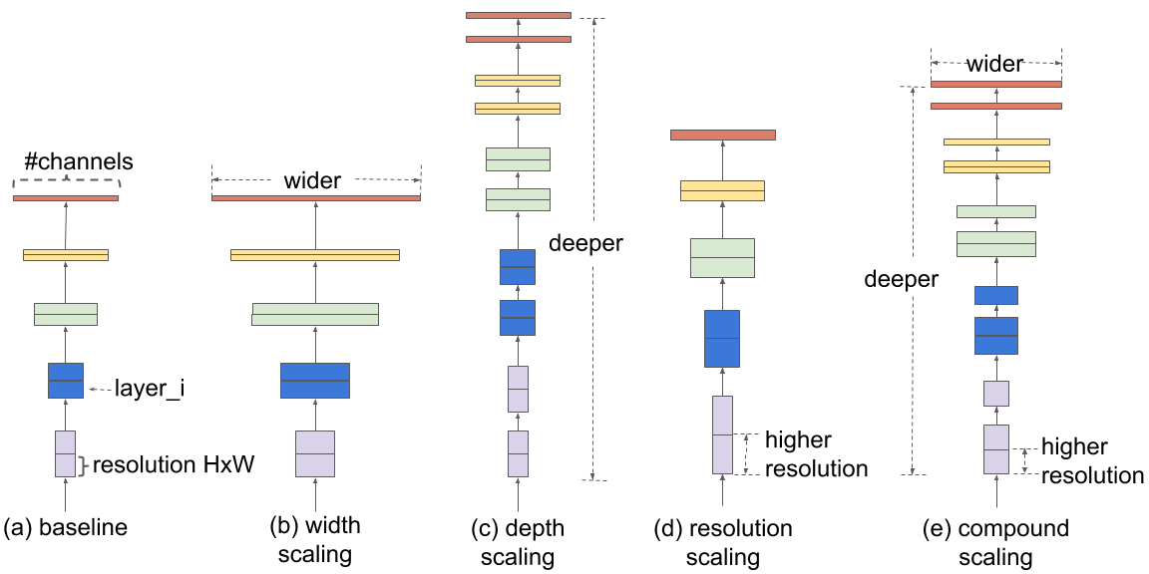
METHODOLOGY
EfficientNet
It is introduced by Google AI. they tried to propose a method that is more efficient as suggested by its name while improving the state of the art results. Generally, the models are made too wide, deep, or with a very high resolution. Increasing these characteristics helps the model initially but it quickly saturates and the model made just has more parameters and is therefore not efficient. In EfficientNet they are scaled in a more principled way i.e. gradually everything is increased.

Slide 30
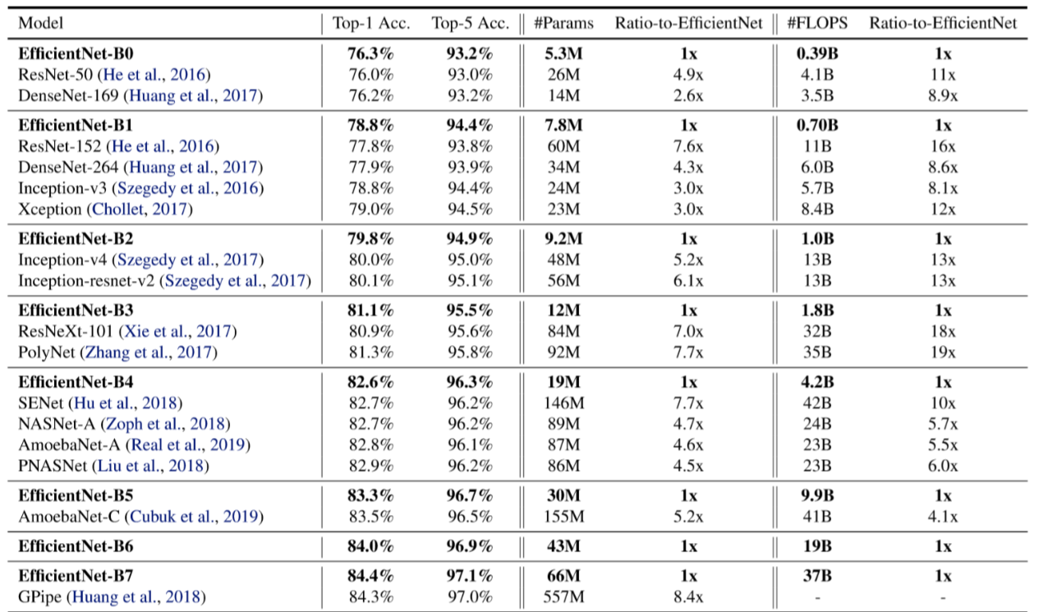
METHODOLOGY
EfficientNet_B0 Results

Slide 31
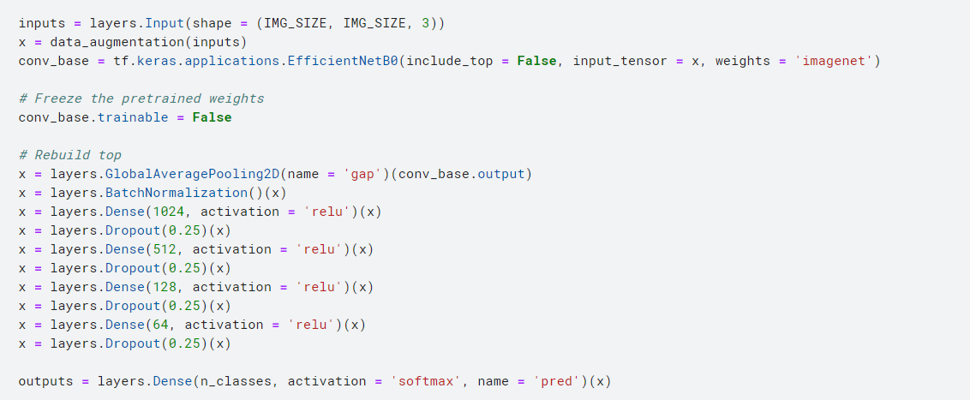
METHODOLOGY
Training The Base Model with pre-trained weights
Here we have taken the weights that are trained on ImageNet dataset and freeze them as non-trainable parameters. The top layer of the Classifier has been modified according to our dataset

Slide 32
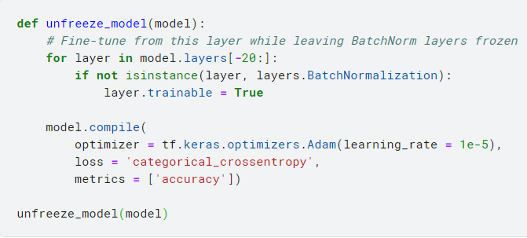
METHODOLOGY
Fine Tuning the Model
In the previous model, we are only training a few layers on top of an Efficient Net base model. The weights of the pre-trained network were not updated during training.
One way to increase performance even further is to train (or "fine-tune") the weights of the top layers of the pre-trained model alongside the training of the classifier you added. The training process will force the weights to be tuned from generic feature maps to features associated specifically with the dataset.

Slide 33
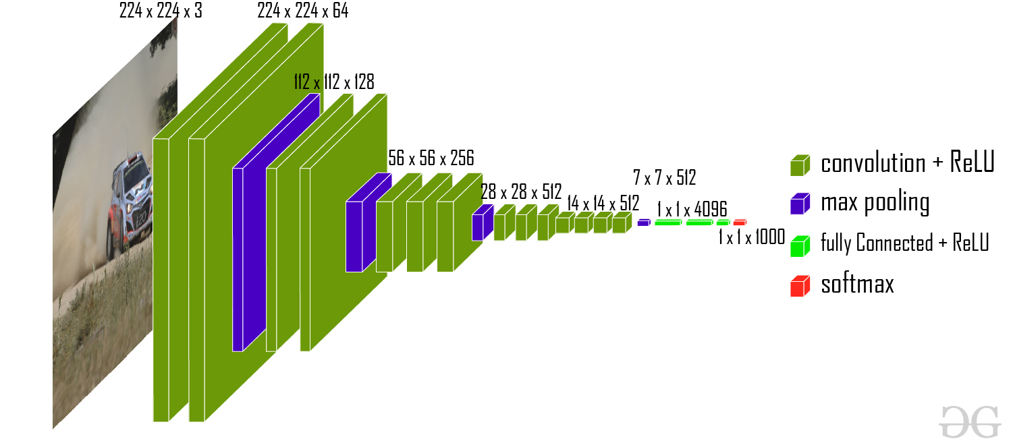
METHODOLOGY
VGG-16
VGG-16 is a convolutional neural network that is 16 layers deep. We can load a pretrained version of the network trained on more than a million images from the ImageNet database. The pretrained network can classify images into 1000 object categories, such as keyboard, mouse, pencil, and many animals. As a result, the network has learned rich feature representations for a wide range of images. The network has an image input size of 224 x 224
VGG-16 Architecture

Slide 34
METHODOLOGY
Recovery solution suggestion for diseases
Data Dictionary of diseases and Recovery Solutions
User Input Image of Rice plant
Saved DL Model
Disease detection
RESULT
Disease and Pesticide solution

Slide 35
RESULTS
Crop and fertilizer recommendation results :
Below table shows the results of the different models that have been built on the crop and fertilizers datasets. Out of all the models random forest has shown the best results. So we have decided to deploy the random forest model.
Task | KNN Classifier |  | Random Forest |  | XGBoost
 | Train | Test | Train | Test | Train | Test
Crop Recommendation | 97% | 95% | 99% | 99% | 99% | 98%
Fertilizer recommendation | 100% | 94% | 100% | 100% | 100% | 100%
Table : Accuracy Results of different models on crop and fertilizer dataset

Slide 36
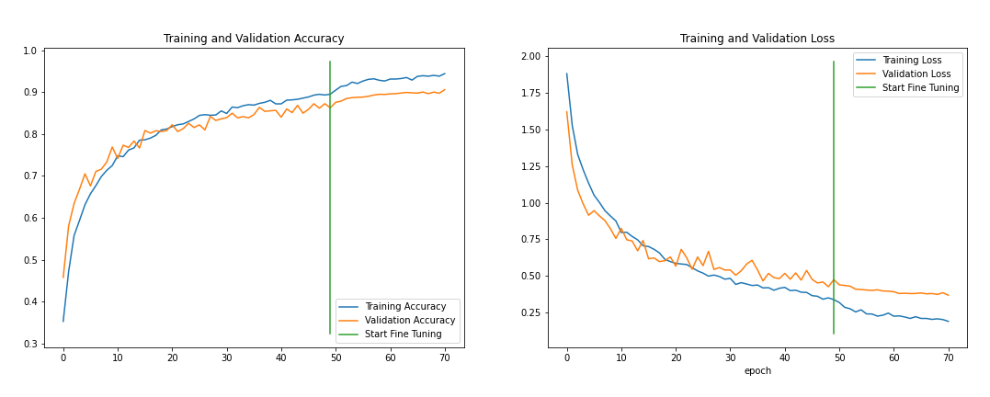
RESULTS
Paddy disease classification results :
EfficientNet - B0 :
Training and Validation Scores of Efficient Net model on Rice disease classification

Slide 37
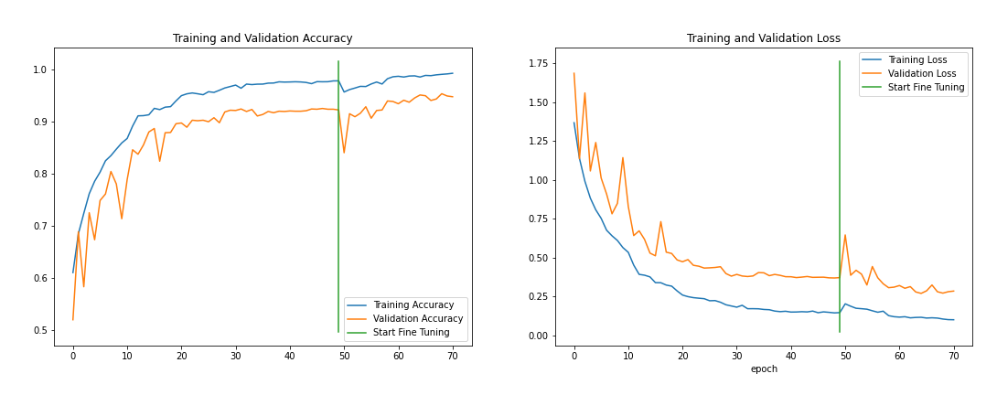
RESULTS
Paddy disease classification results :
VGG-16
Training and Validation Scores of Efficient Net model on Rice disease classification

Slide 38
RESULTS
Paddy disease classification results :
Architecture | Training accuracy | Validation Accuracy | Testing Accuracy
Custom Model | 73% | 62% | 60%
EfficientNet B0 | 94% | 90% | 88%
VGG16 | 98% | 95% | 94%
Training and Validation Scores on Paddy disease dataset

Slide 39
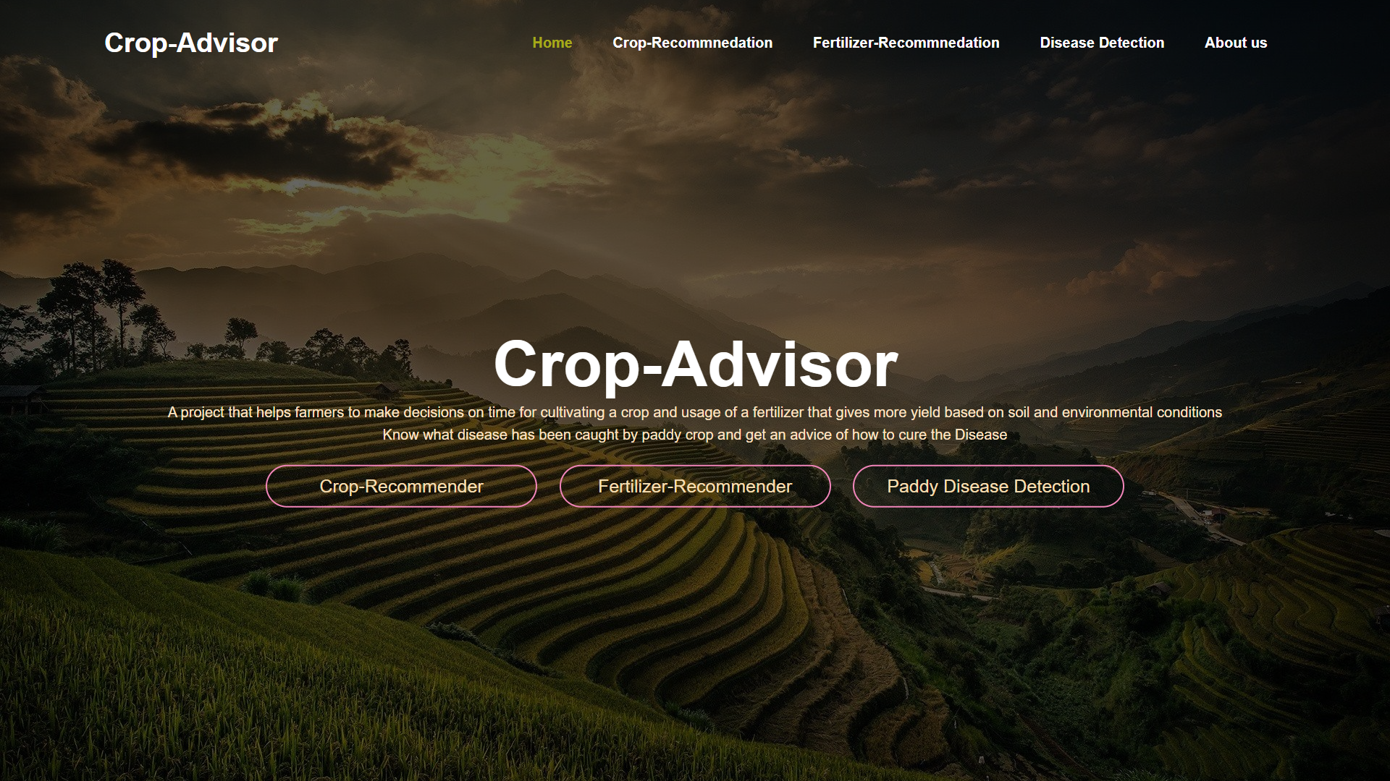
RESULTS
Web Application Results :
Home page

Slide 40
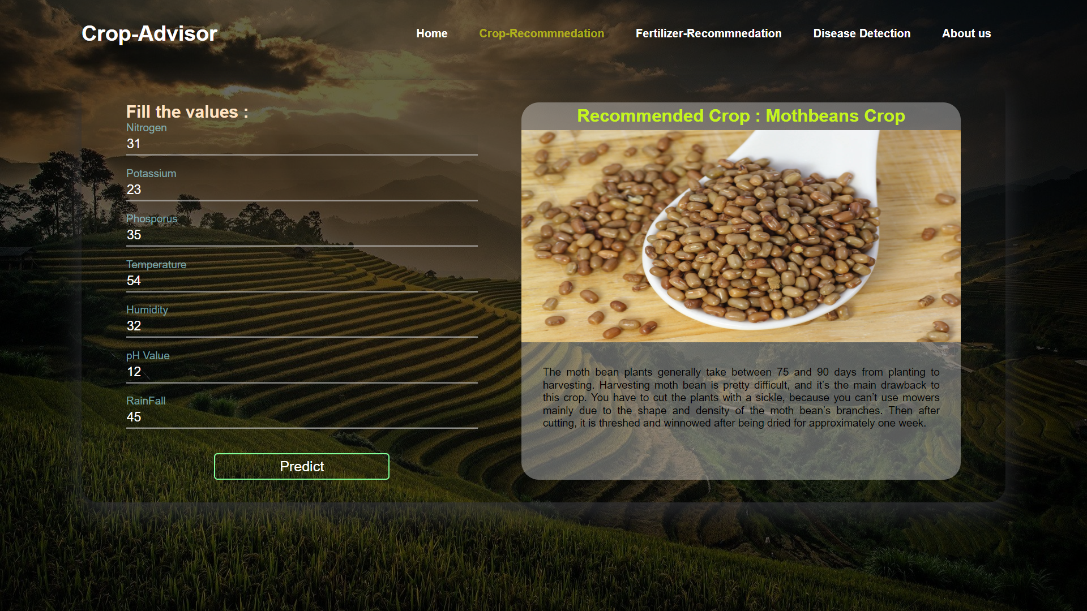
RESULTS
Crop Recommendation

Slide 41
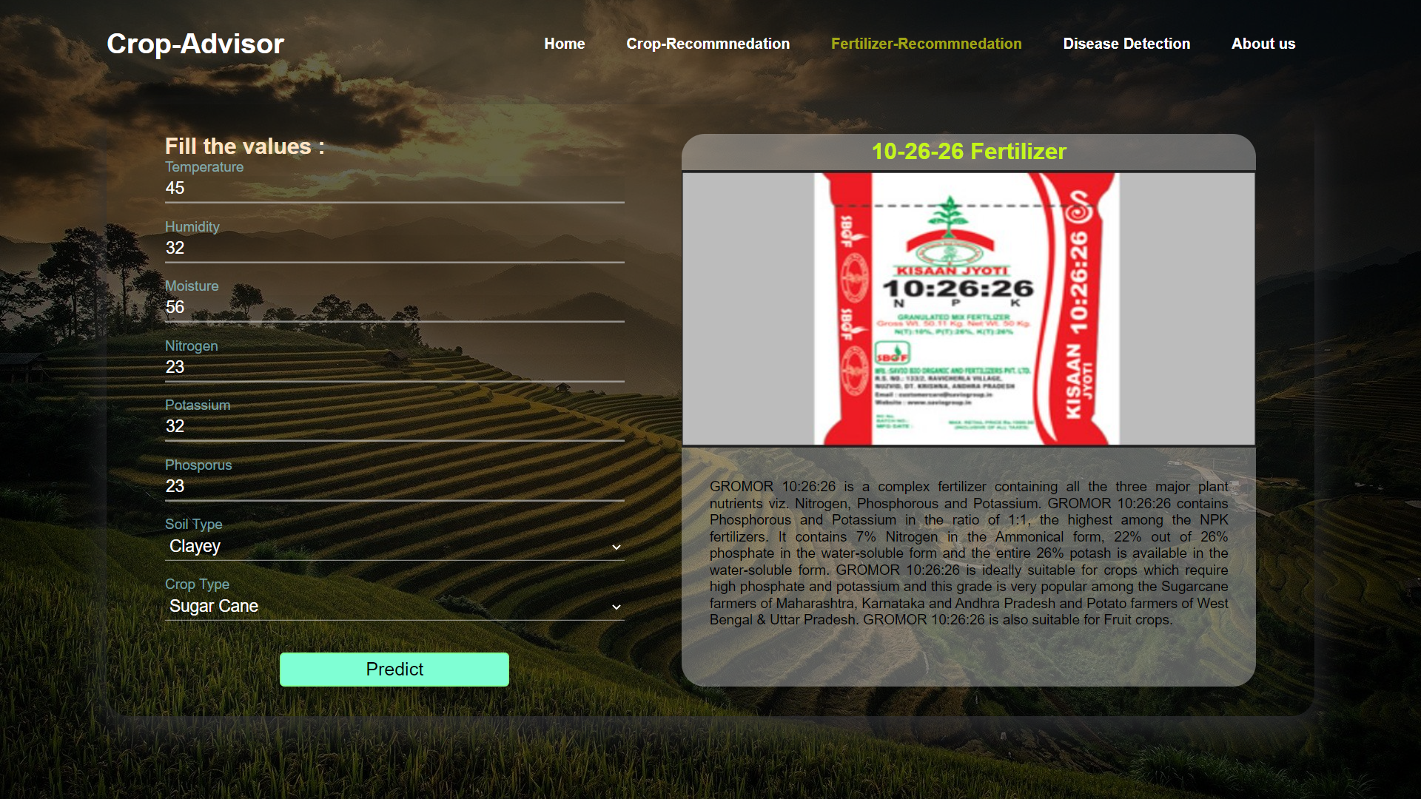
RESULTS
Fertilizer Recommendation

Slide 42
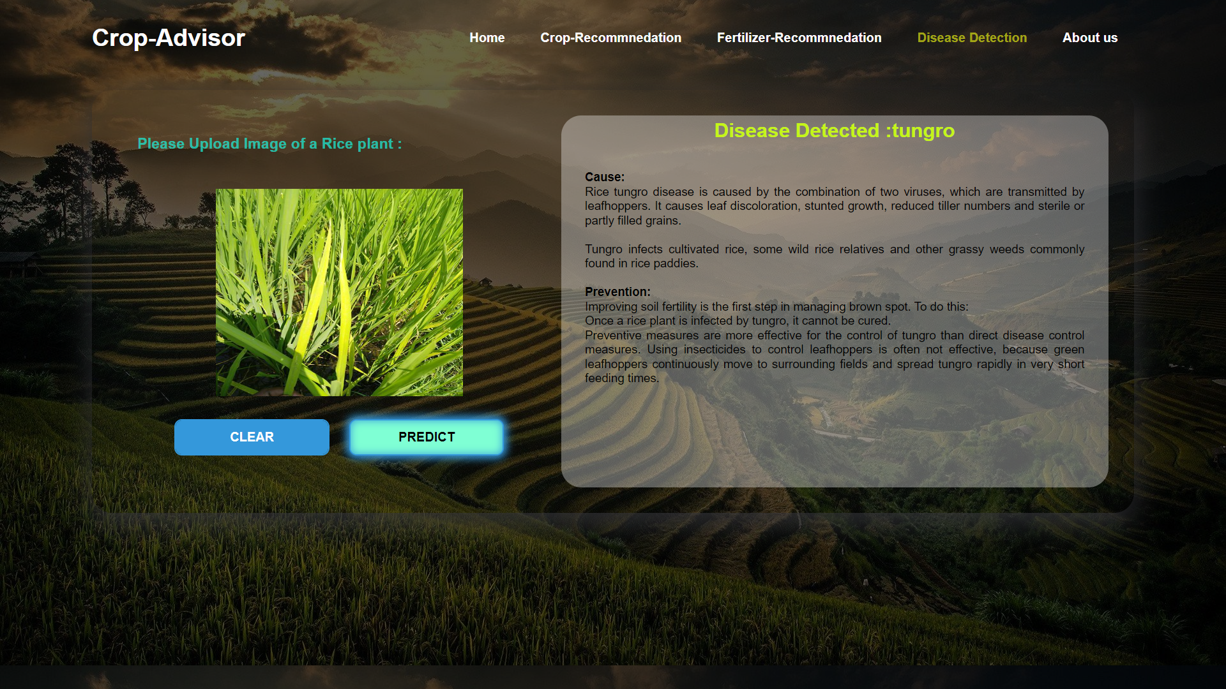
RESULTS
Paddy disease classification

Slide 43
CONCLUSION
Main aim of the project is to develop a system that can help farmers to make decision while cultivating several crops. We have developed 3 features within this project Crop recommendation and fertilizer recommendation to get more yield out of the crop. Paddy disease classification to know what kind of disease that has been occurred in the rice field out of 10 types of diseases. We have used KNN classifier , Random forest and XGBboost models for the classification purpose. Among those Random forest performed very well. While coming to paddy image dataset we have used transfer learning approach to build the efficient image classification models. VGG16 model that was built with imagenet weights has given better result on both training and testing images. After finetuning the transfer learning models has increased their learning capacity. After model building phase a web application with an user friendly interface has been made by using HTML,CSS,JavaScript as frontend of the system and Flask API as the backend of the system.

Slide 44
REFERENCES
M. Alencastre-Miranda, R. M. Johnson and H. I. Krebs, “Convolutional Neural Networks and Transfer Learning for Quality Inspection of Different Sugarcane Varieties,” in IEEE Transactions on Industrial Informatics, vol. 17, no. 2, pp. 787-794, Feb 2021.
Li, Wei, Tengfei Zhu, Xiaoyu Li, Jianzhang Dong, and Jun Liu. 2022. “Recommending Advanced Deep Learning Models for Efficient Insect Pest Detection Agriculture”
Elavarasan, D., & Vincent, P. M. D. (2020). “ Crop Yield Prediction Using Deep Reinforcement Learning Model for Sustainable Agrarian Applications”. IEEE Access
S. I. Hassan, M. M. Alam, U. Illahi, M. A. Al Ghamdi, S. H. Almotiri and M. M. Su’ud, “A Systematic Review on Monitoring and Advanced Control Strategies in Smart Agriculture,” in IEEE Access
Mishra, Subhadra, Debahuti Mishra, and Gour Hari Santra. “Applications of machine learning techniques in agricultural crop production: a review paper.” Indian Journal of Science and Technology.
Ganesh, Patil. “Leaf Disease Detection and Selection of Fertilizers using Artificial Neural Network.” (2017).
Chen, J., Zhang, D., Nanehkaran, Y.A. and Li, D. (2020), “Detection of rice plant diseases based on deep transfer learning”. J Sci Food Agric.

Slide 45
REFERENCES
Bm, Sagar & Cauvery, N.K. (2018). “Agriculture Data Analytics in Crop Yield Estimation: A Critical Review”. Indonesian Journal of Electrical Engineering and Computer Science.
Senthil Kumar Swami Durai, Mary Divya Shamili, “Smart farming using Machine Learning and Deep Learning techniques”, Decision Analytics Journal,
R. Alfred, J. H. Obit, C. P. -Y. Chin, H. Haviluddin and Y. Lim, “Towards Paddy Rice Smart Farming: A Review on Big Data, Machine Learning, and Rice Production Tasks,” in IEEE Access.

Slide 46
Queries?

Slide 47


